Slide 1
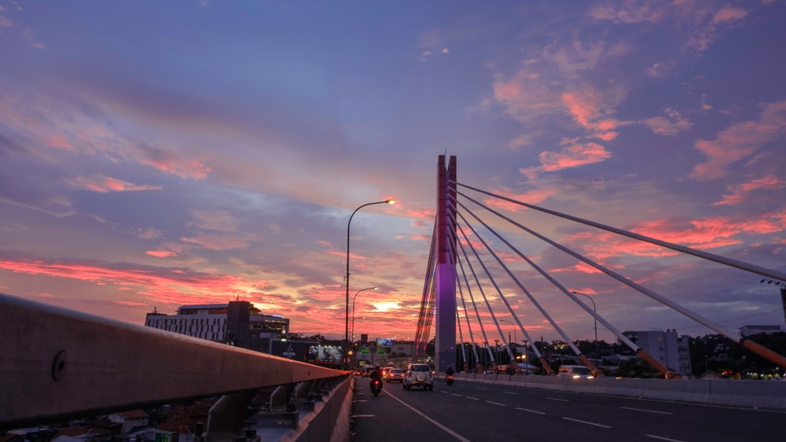


Recommendation for Hotel Construction
in Bandung, Indonesia through Clustering Analysis
Written for Applied Data Science Capstone Final Project
In IBM Professional Data Science Certificate
By: Satria A.W. Bakri

Slide 2
Problem Description
Hotel Franchise A decides to open a hotel in Bandung, Indonesia. Before beginning the construction, they want to analyze which part of the town the hotel should be built. A survey is deployed to the board of commissioners and other relevant stakeholders. The first and most important criterion that they want is that the hotel is located to as many point-of-interests/attractions as possible. Therefore, the analysis of neighborhood venues is necessary to be performed

Slide 3
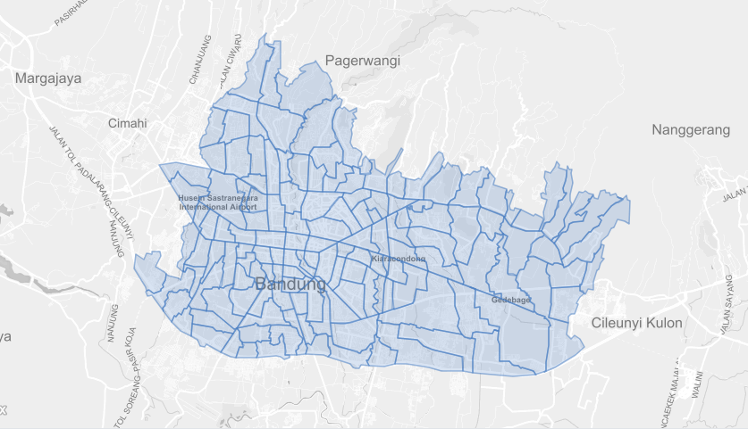
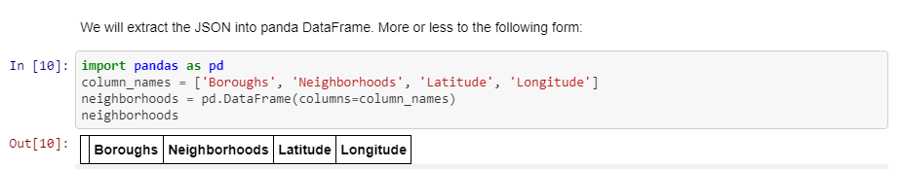
Data
Geo-Location
Specific Geo-Location data will be needed to do the analysis, specifically the coordinates (latitude and longitude) of all boroughs and neighborhoods in Bandung, Indonesia. Through the search, the writer decides to borrow Geo JSON data of Bandung in https://github.com/tyohan/bandung-map-dataset . Thank you for the author.

Slide 4

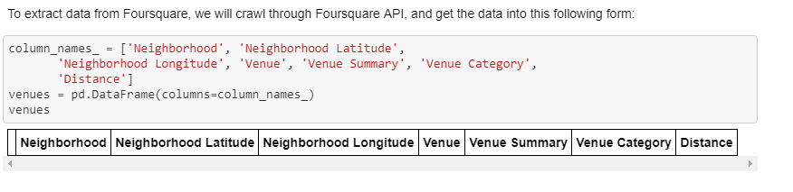
Data
2. Venues Data To understand the position of venues we need the list of venues in each of the neighborhood and their latitude-longitude data. Another important data is the venue category. To simplify the project, we will only use K-Means Machine Learning clustering algorithm on venue categories. Other informations such as Venue Summary and Distance can be used as additional deciding factors. These data will be gathered through Foursquare Open API. More about Foursquare Open API can be read on https://foursquare.com/developers/apps

Slide 5
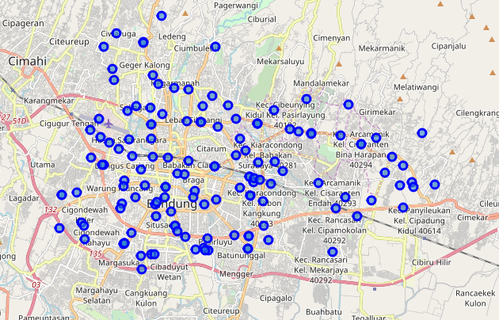
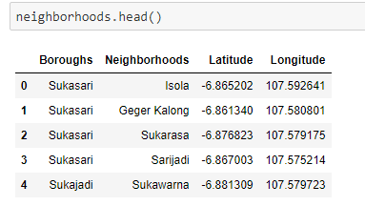
Methodology & Result
Part 1: Gathering Neighborhoods and Their Coordinates
Load JSON file
Extract boroughs, neighbourhood and coordinates.
Understand the number of boroughs and neighbors: 26 boroughs and 139 neighborhoods.
Plot to Bandung Map using Folium

Slide 6
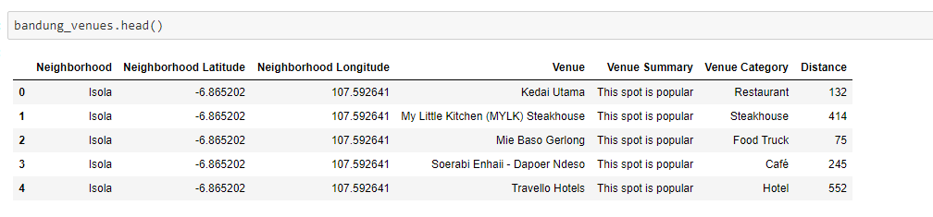
Methodology & Result
Part 2: Gathering Venues Data in Bandung and Cleaning Them
Pass in Foursquare Credentials
Using crawler, send GET request to crawl for venues data and gather their longlat, venue name, summary, category and distance
Transform into pandas DataFrame
Save to CSV

Slide 7
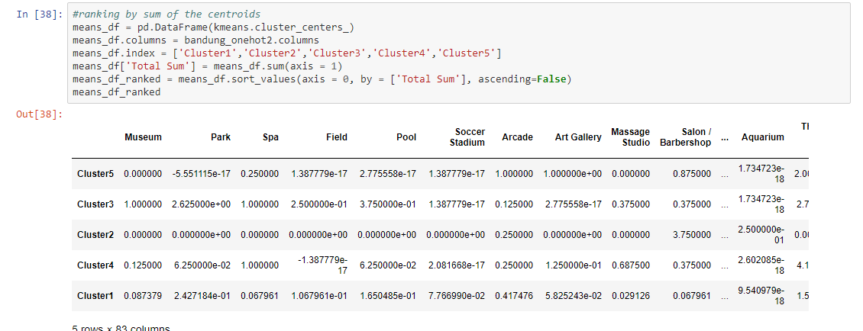
Methodology & Result
Part 3: One-hot Encoding of Venues
Extract unique categories
Make one-hot encoding data frame
Manually eliminate non-traveling destination categories.
Group by neighbourhood, plot to the selected unique categories

Slide 8
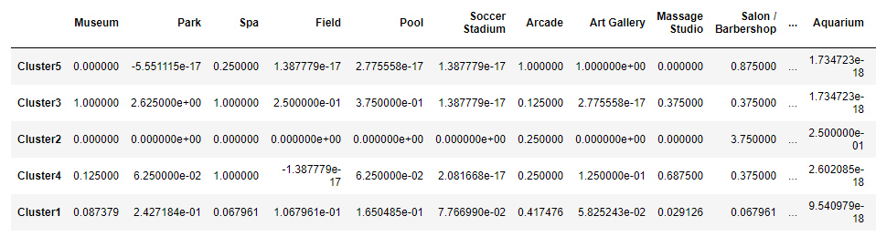
Methodology & Result
Part 4: Machine Learning Step, Clustering by K Means
Run k-means clustering on one-shot dataframe. Number of clusters = 5
Calculate each centroids of venue categories

Slide 9

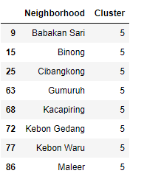
Methodology & Result
Part 4: Machine Learning Step, Clustering by K Means, continued
Rank them by the sum of centroids per cluster
It is found that:
And the neighbourhood belonging to Cluster 5 are:

Slide 10
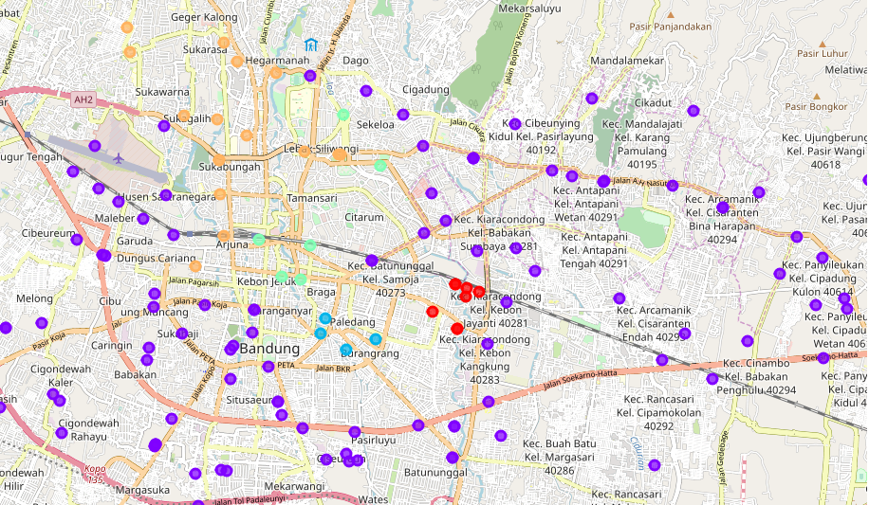
Methodology & Result
Part 4: Machine Learning Step, Clustering by K Means, continued
Plot the clusters into Folium. The red circles are Cluster 5

Slide 11
Conclusions
After using K-Means as clustering algorithm, it is found that the best neighborhoods to build the hotel (based on the proximity to point-of-interest/attraction venues) is Cluster 5, which includes Babakan Sari, Binong, Cibangkong, Gumuruh, Kacapiring, Kebon Gedang, Kebon Waru and Maleer neighborhood.

Slide 12
THANK YOU

